Slide 1

Welcome!
Thank you for joining today’s webinar: Easing Peak Load Stress During System Upgrades
If you have a question please use the question box located on the right side of your screen.
Questions for our speaker will be addressed at the end of the presentation.
This webinar will be recorded for future playback.

Slide 2
Reminders
Recording and slides from this presentation will be available at www.openadr.org.
The OpenADR Webinar Series will continue throughout 2016. More information on future webinar topics can be found on www.openadr.org.
Be sure to visit the OpenADR Alliance along with co-exhibitors: BPL Global, GridPoint, GridWiz, Honeywell, QualityLogic, and IP Keys at DistribuTECH 2016 in Booth 413

Slide 3
Today’s Speaker
Mark Kerbel, CTO and co-founder of Encycle (formerly known as REGEN Energy), developers of the Swarm Energy Management platform, primarily deployed for commercial & industrial HVAC load control. Mark is chair of the OpenADR Marketing Working Group and a longstanding member of the OpenADR community.
Contact: mark.kerbel@encycle.com

Slide 4


Easing Peak Load Stress During System Upgrades
Rich Philip, Duke Energy
Mark Kerbel, OpenADR Alliance
PLMA Fall 2015 Conference

Slide 5
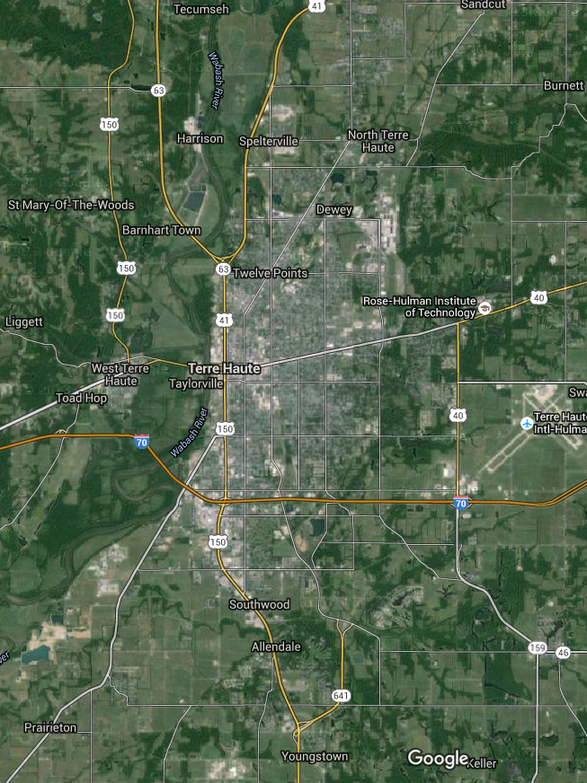
System upgrades in progress… but soon enough?
Due to mercury rules, a coal station near Vigo County, IN will be decommissioned in April
New transmission lines required… but halted for now
Terre Haute may have a 20-40MW overload at peak conditions
Capacity needs to be ready by June ➔ Need to evaluate options feasible for Jan-Apr rollout
Examining DR and EE measures as part of an overall mitigation strategy

Slide 6

Distribution Consumer Characteristics
Vigo Country, IN: Population 110,000
High humidity and +85F temps could spawn reliability problems
Annual highest temp usually 93F
In 2011, experienced 8 straight days > 100F
Duke Energy: 10,000 consumers in the impacted area
~9,000 Residential consumers, ~3-3.5kW each
~900 C&I, 100kW-500kW customers
~100 larger customers, up 15MW

Slide 7

What options exist given the timelines?
Residential consumers: No existing thermostat/switch program, unfeasible to implement by June
Large Industrials: 10 large industrials who may be able to shoulder the bulk of the curtailment request, but not provide all the MW required
C&I: How can a DR program be rolled out in Jan-Apr?

Slide 8

What adt’l benefits for C&I consumers are derived beyond grid stability this summer?
C&I consumers receive higher than usual DR capacity payments:
  ➔Need to provide higher capacity payments than typical DR programs to grab attention quickly (“Time limited offer”)
  Further increase payments if consumers can perform with 5-min notice, and/or provide firm reduction capabilities
  Could feed DR into MISO reserve market later to continue DR payments after 2016
Utility can use this as an opportunity to enhance EE & DR, show consumers that the utility cares (and not simply dictates measures)
  ➔ Lead with DR, allowing consumers to direct payments to other EE measures (and possibly offer even more kW for DR)

Slide 9

What do we need?
An established platform, already in use at other utilities…
…that can be quickly deployed for use by utility’s control room to manage a few hundred C&I consumers
…that can be quickly deployed to control a variety of gear installed at different C&I consumers’ facilities
…where consumers’ equipment can act on DR event notices within 5 minutes
…where feedback is provided to the control room in near real-time
…where installation & commissioning at sites can be completed in weeks or days, not months

Slide 10
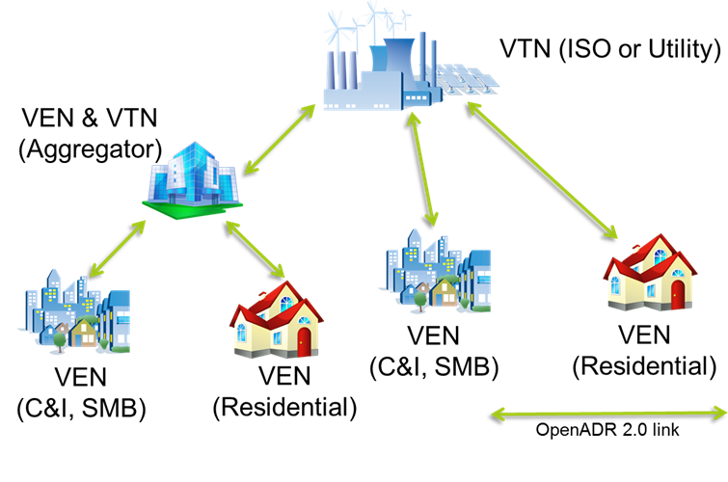
What is OpenADR?
A secure message exchange protocol between…
Virtual Top Nodes (VTN)
  Register, manage sets of resources
  Create/transmit event notices
  Request telemetry
Virtual End Nodes (VEN)
  Authenticate with a VTN
  Receive events and respond to them
  Control demand side loads
  Provide telemetry
Communicates what needs to be done, but not how (which is left to the consumer to decide)
“Always on” – VENs expected to check in every minute to verify ability to receive event requests

Slide 11

What is OpenADR?
An Open web-services specification that promotes interoperability
An industry alliance backed by utilities and vendors, first used in 2003
A platform used across the U.S. and internationally, designed for utility-to-consumer DR program interaction
A standard that conforms to NIST Smart Grid Interoperability Framework
A vibrant ecosystem of products that have successfully completed a certification program, including 50 certified VEN products alone

Slide 12
How can an OpenADR platform be deployed in time?
Derive an Implementation Guide with the specifics of
the program (based on the existing OpenADR 2.0 IG)
  Specify program naming conventions (e.g. DA, DO),
  even program characteristics (e.g. hours of the day)
  Specify event notification timelines & durations
  Specify requested action, simplify to 1 signal type
  Specify telemetry to be provided, simplify to show loads under control
An IG provides vendors with a clear understanding of how OpenADR will be used, simplifies derivation of testing, expedites roll-out
Vendors must commit to implementing solutions per the IG in time

Slide 13
How can an OpenADR platform be deployed in time?
VTN: Select a certified 2.0b cloud-based service
Develop VEN registration & commissioning protocols
Understand your C&I customer base:
  List C&I accounts grouped by SIC code, sorted by peak demand
  Prioritize any that previously engaged in EE programs
  Prioritize those that National Account managers can determine have facilities in the service territory
VENs: Select a list of certified 2.0b VEN vendors that:
  …each have experience with the size & SIC types of C&I consumers
  …can demonstrate the ability to commission sites in days or weeks
  …are willing to work with the utility to canvas consumers in the timelines required

Slide 14
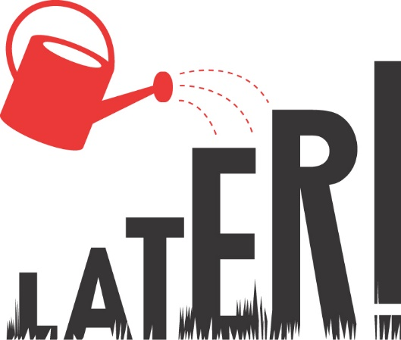
What happens to the OpenADR platform after 2016?
Assuming the DR resources feed into other programs (e.g. MISO reserve market)
Migrate VTN from cloud-based to utility in-house system
Target best performing C&I consumers for EE program follow-up
Could consider expanding:
…IG to provide a wider variety of DR programs
…List of VEN vendors to allow more parties to participate in the service territory
…The program to include residential resources
(e.g. OpenADR certified thermostats)

Slide 15
Follow OpenADR
Follow: @OpenADRAlliance
Connect: OpenADR Alliance Open Group
Like: OpenADR Alliance
Explore: OpenADR Alliance Channel

Slide 16
Rolf Bienert Barry Haaser
Technical Director Managing Director rolf@openadr.org barry@openadr.org
+1 925 336 0239 +1 408 310 9213
Thank You!
Shannon Mayette
Marketing Director
shannon@openadr.org
+1 602 882 4733
www.openadr.org

